Slide 1
Machine Learning in the real world
Machine Learning
2016-> All about Frameworks (TensorFlow, CNTK, etc..)
2017 -> Training at Scale (GPUs, etc.)
2018 -> MLOps (AIOps)
2019 -> automl
2020 -> citizen data scientists?
Machine learning adoption journey
Data
Models
Deployments
Process

Slide 2
Real world example – Law Firm
Has an established Dev Ops system
2 Data Scientist Consultants
All did their own Offline experiments
Some used Python in a notebook
Some used Azure Databricks
After we showed a great model, chaos ensued!
We spent 2 months creating a DevOps model pipeline
We learned
Model Reproducibility
Repo template, best practices around source control, ML pipelines
Model Storage & Versioning
Centralized enterprise "model store" (git + ADLS based)
Tooling to track and manage versions and metadata
Model Validation
Unit testing, functional tests
Model Deployment
CI/CD tasks in Azure DevOps for package/test/deploy to inference stack

Slide 3
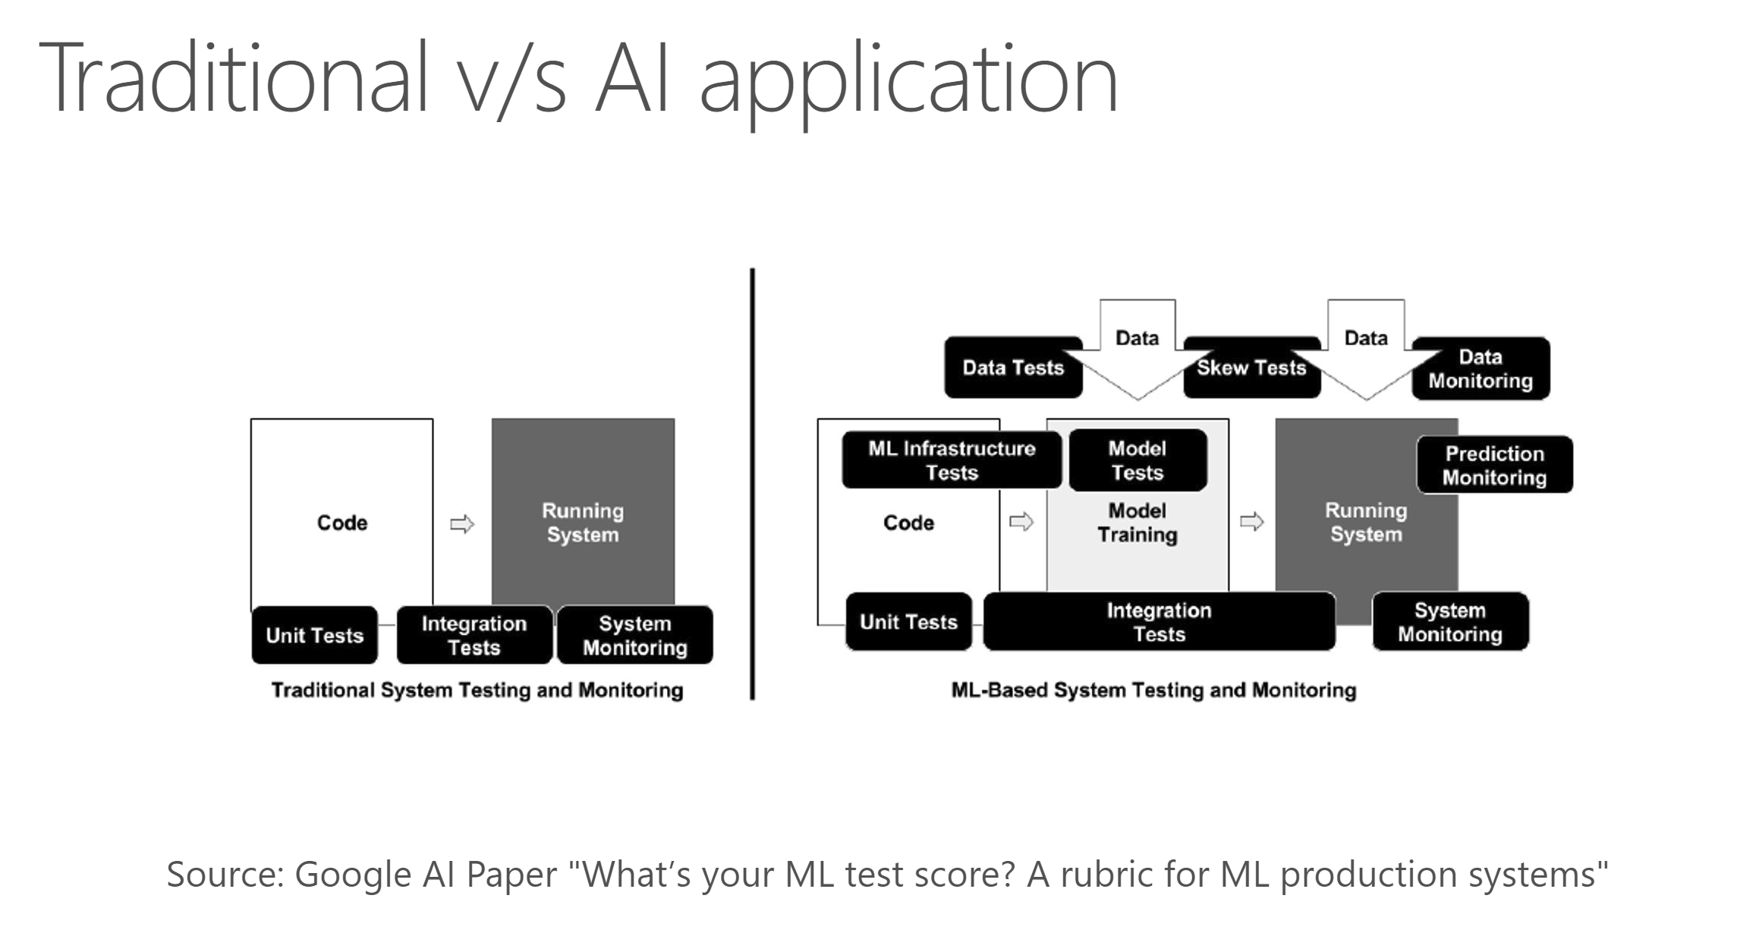

Slide 4
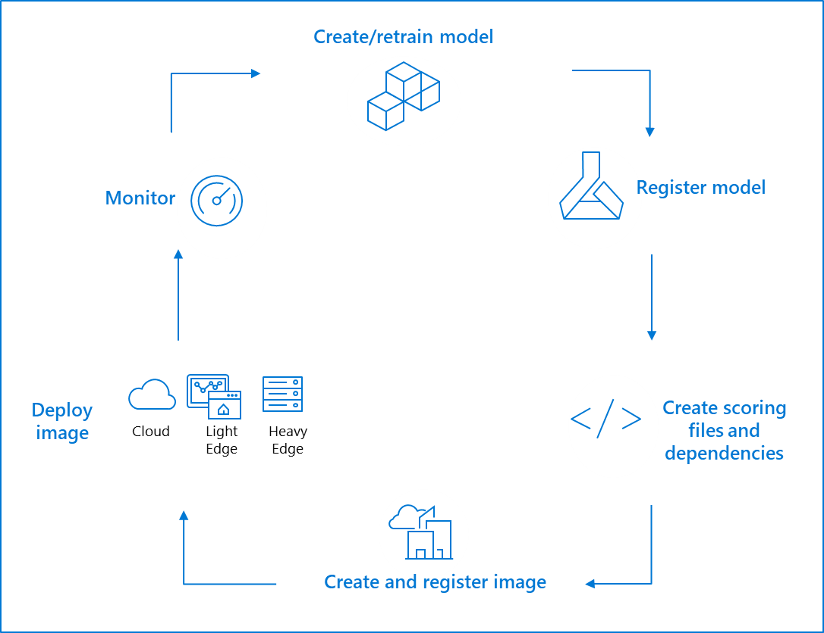
Machine Learning Ops
ML lifecycle management
CI/CD for ML pipelines
Feedback loop
-> Automate everything
-> Orchestrate w/ DevOps
Integrated with Azure DevOps

Slide 5
Machine Learning Pipelines
Refactor into multiple Steps in a Pipeline
Automatable – CLI, REST
Unattended runs
Diverse Compute
Reusability
Tracking and versioning
Automate with Azure DevOps
Training data changes
Feedback data triggers
Training code changes
Move from
ADLS
Move from
SQL
Split & featurize
Train
Validate
Deploy
https://docs.microsoft.com/en-us/azure/machine-learning/service/concept-ml-pipelines

Slide 6
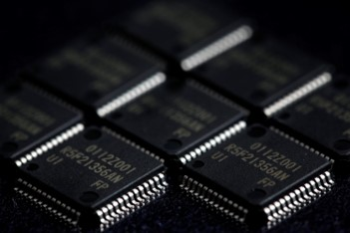
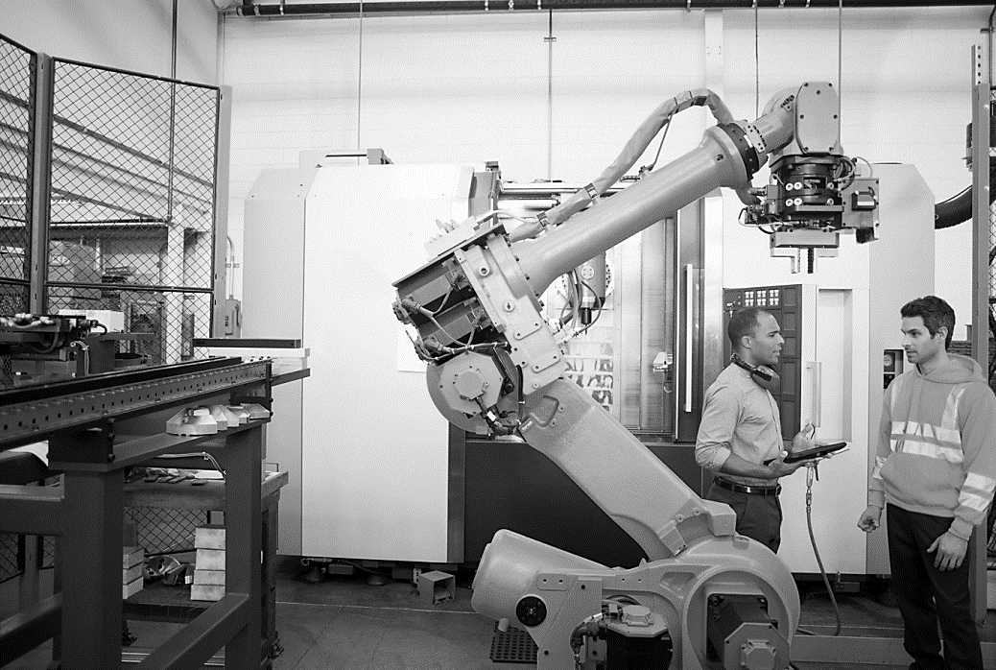
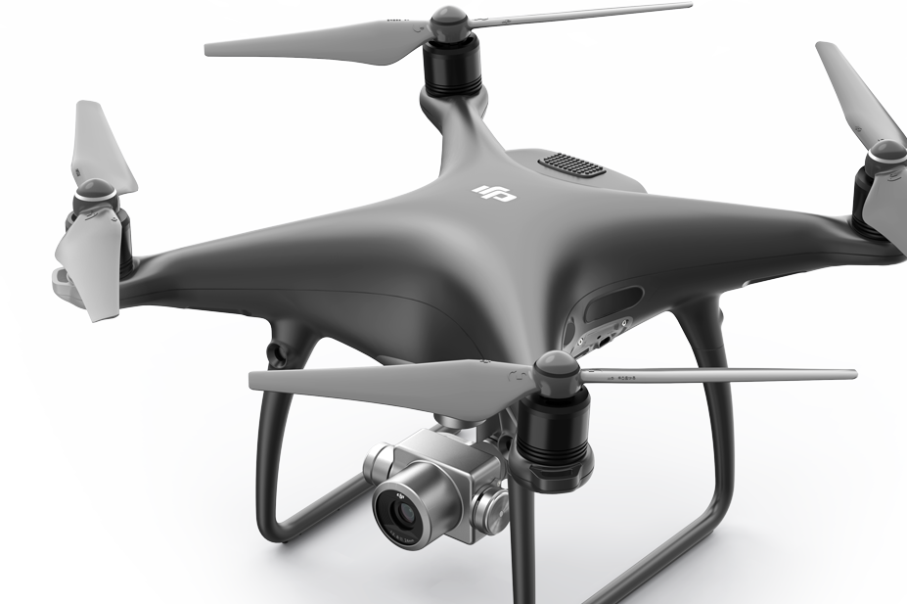
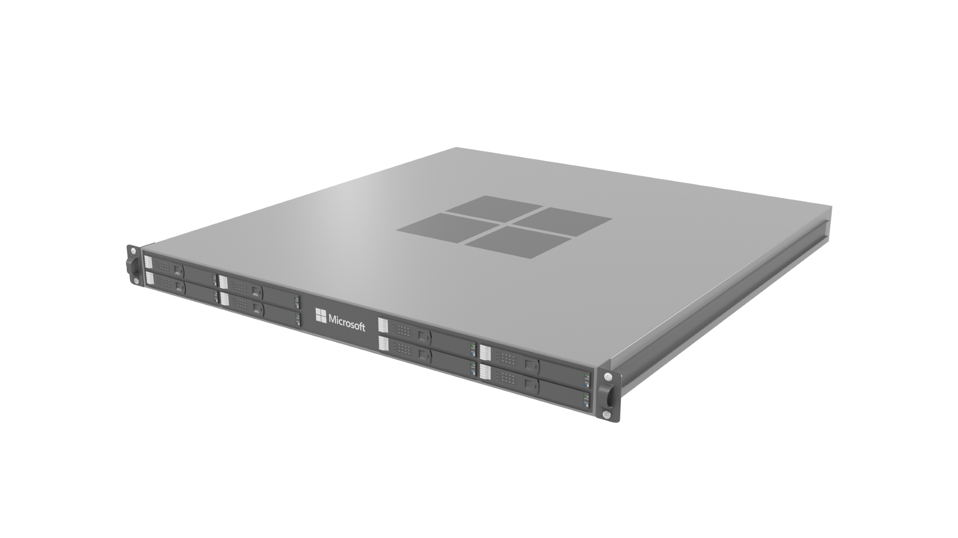
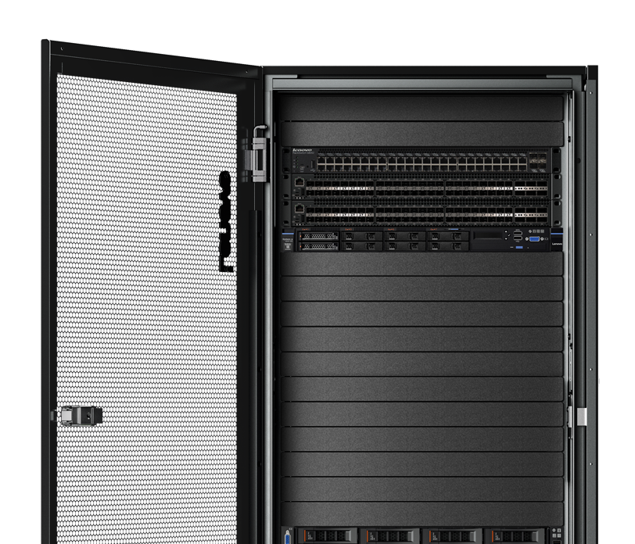
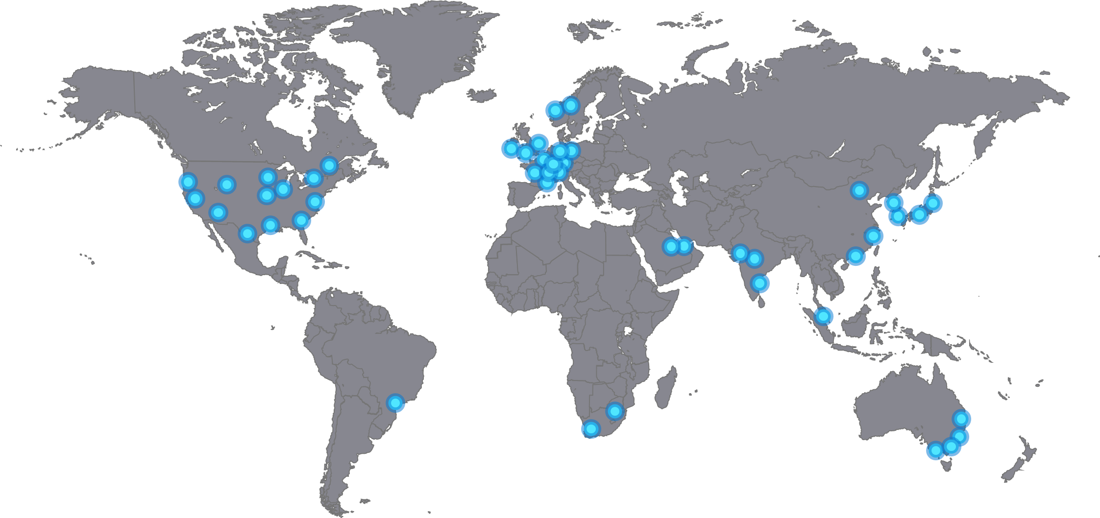
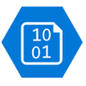





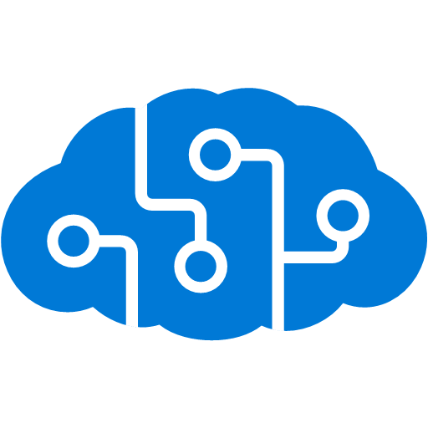



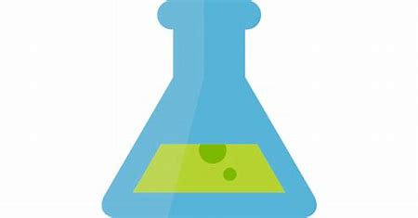
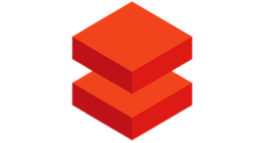

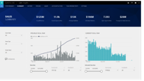



Intelligent Edge + Cloud
Sensors + control
Sensors to interactive
Integrated platform
Global scale processing
MCU based
IoT devices
Edge devices
Edge appliances
Edge cloud
Hyperscale cloud
Inferencing
Inferencing
Inferencing
Inferencing
Inferencing
Inferencing
Training
Training
Training
Training
Training
Training
Data
Data
Data
Data
Data
Data
Custom AI model
Custom AI model
Custom AI model
Custom AI model
Custom AI model
Custom AI model
Less aggregated data and insights
Full spectrum of data collection and aggregation using Azure Storage
More aggregated data and insights
Less AI functionality
Azure AI functionality availability based on computational resources
Most AI functionality
Microsoft Confidential
6

Slide 7
Deployment to Cloud & Edge
Cloud
Register Model ->
Build Container ->
Deploy to AKS ->
Model Telemetry
Edge
Register Model ->
Convert model ->
Build endpoint specific container ->
Register in IoTHub ->
Deploy to Iot Edge ->
Model Telemetry
Cognitive Services
Azure ML model management
Kubernetes, AML Compute
Optimization
Azure ML experimentation
Packaging
IoT Hub
IoT Edge
Validation
ADB, onprem, etc.
Deployment
DataBricks, onprem, etc.

Slide 8
Edge AI
Endpoint specific - Today
Optimize the model (incl. hand tuning)
Include all device SDKs
Device Specific Scoring files
Consistent Software platform – H2FY19
IoT Edge AI certification level
ONNX runtime (incl. most optimizations)
Hardware specific execution providers
Auto Generated Scoring files
IoT Device
Model Container
Score file
ONNX Model
Execution Provider
HW Accelerator

Slide 9
App Dev and Data Scientists working together

Slide 10
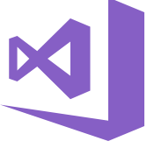


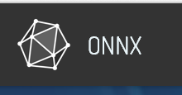
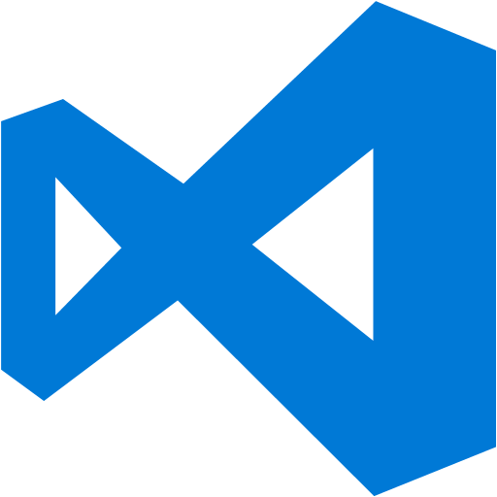





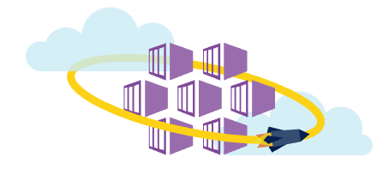
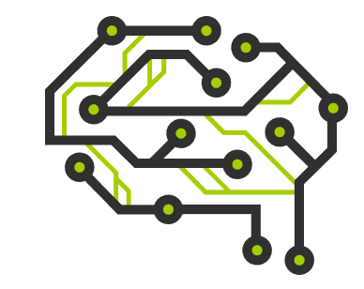
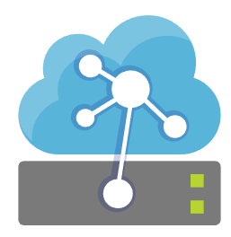
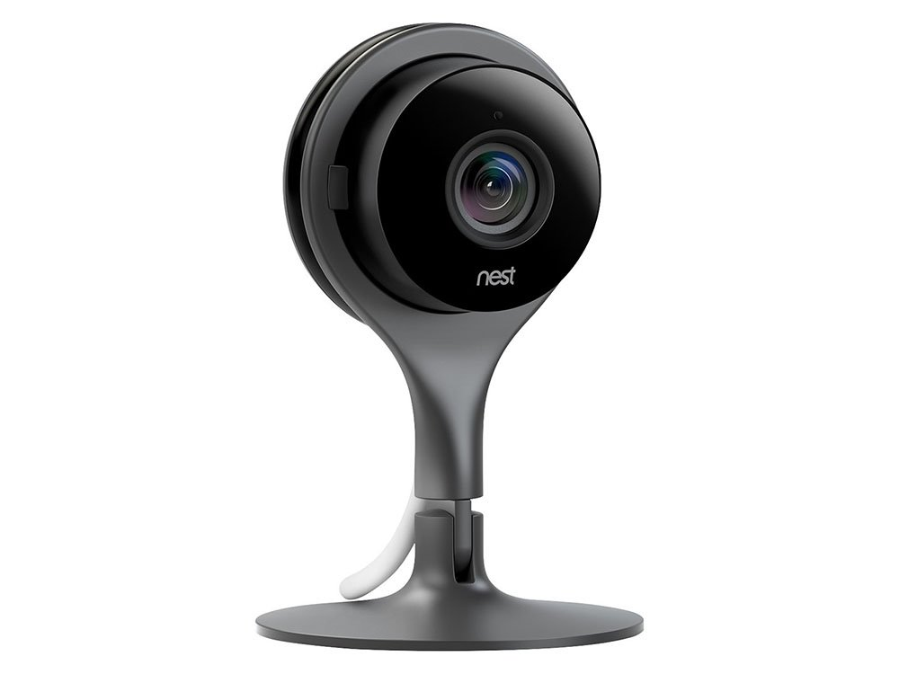
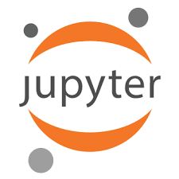

ML + Application Dev Process
Update Application
Cntk/Tf/Scikit
Keras/ …
Deploy Application
Cloud Services
App Developer
IDE
DevOps Pipeline
Validate & Flight Model + App
Consume Model
Deploy Model
Apps
Customize Model
Model Store
Predict
Edge Devices
Publish Model
[ { "cat": 0.99218,
"feline": 0.81242 }]
Data Scientist
Retrain Model
Model Telemetry
Collect Feedback
IDE

Slide 11
Under the hood
Data Ingestion
Code change, trigger CI
New inference code, trigger release
DevOps Pipeline
TRAIN MODEL
Training code
Inference code
Git Repo
New training job is started whenever source code is pushed.
ML Pipeline handles dataPrep, training, evaluation – certifies the model is of high quality
Register Model
Data Cooking Pipeline
Data Lake
Unit Test Code
Model Store
Run Azure ML Pipeline
New data, trigger CI
Azure Data Factory Pipeline
Azure Databricks
Azure ML Compute (docker run)
New model registered, trigger release
Data Preparation Services (Labeling, Feedback, Drift)
Data movement / copy
Data cooking
Model training
Inference code has changed, trigger release pipeline
DEPLOY MODEL
DevOps Pipeline
Azure DevOps
Inference Data
Deploy to Kubernetes or IoT Hub
(PROD)
Get Human Approval
Validate Model
Deploy to Azure Kubernetes or IoT Hub (INT)
Package Model
Azure Machine Learning
Azure Data Factory

Slide 12
Productive Services
Customer journey
Data Prep
Build and Train
Manage and Deploy
Python ML developer
Azure ML service
Azure ML service
Azure ML service
(Pandas, NumPy etc. on AML Compute)
(OSS frameworks, Hyperdrive, Pipelines, Automated ML, Model Registry)
(containerize, deploy, inference and monitor)
+
Apache Spark / Big Data
Azure Databricks
Azure Databricks + Azure ML service
Azure ML service
(Apache Spark Dataframes, Datasets, Delta, etc.)
(Spark MLib and OSS frameworks + Automated ML, Model Registry)
(containerize, deploy, inference and monitor)

